Slide 1
Lists, List Comprehension, Strings
and Multiple Inputs

Slide 2
Feedback
How comfortable are you with material so far
Green: Very Comfortable
Yellow: Moderately Comfortable
Red: Not comfortable

Slide 3
Operations on a List - Adding Data
Multiple operations are provided on a list object
Syntax of an operation on an object: var_name.opname()
If the var L is a list, some operations that can be done are:
L.append(item) # adds an item to the end of L
L.insert(i, item) # insert item at i th location in L - earlier items from i onwards are pushed back (i.e. their index increases)
L.extend(list) # append the list to L, (the argument must be a list)

Slide 4
Operations on a List - Removing Data
Multiple operations provided for removing items from a list L, e.g
L.remove(item) # removes the item if it exists (first occurrence only), else gives ValueError
L.pop(index) # removes L[index] item ; if no i specified, removes last item
L.clear() # clears the list; L becomes an empty list: []
Items can also be removed from the list using the del function:
del L[index] # removes the item at the specified index

Slide 5
Operations on Lists - others
L.index(item) # returns the lowest index where the searched item appears
L.reverse() # reverses the order of list elements, updates the existing list, does not return any value
L.count(item) # give the no of times item occurs in L

Slide 6
Quiz : Single Correct
What would be the output of the code given on the right?
Error
[8, 12]
[1, 2, 3, 4, 1, 2, 3, 4]
[1, 2, 1, 2, 3, 4, 3, 4]
list1 = [1, 2]
list2 = [3, 4]
print ((list1 + list2)*2)

Slide 7
Quiz : Single Correct
What would be the output of the code given on the right?
Error
[8, 12]
[1, 2, 3, 4, 1, 2, 3, 4]
[1, 2, 1, 2, 3, 4, 3, 4]
Explanation: Recall that + is for concatenation and * is for replication
list1 = [1, 2]
list2 = [3, 4]
print ((list1 + list2)*2)

Slide 8
Example
Given a list as input, write a program to create a new list that has products of frequency of repeating elements (which come together) and value of elements.
Input :
lst = [2, 2, 2, 2, 5, 5, 5, 8, 8, 8, 8, 8, 6, 6, 6, 6, 4, 4, 7, 7, 7, 5, 7,7]
Output :
res = [8, 15, 40, 24, 8, 21, 5, 14]
res = []
count = 1
for i in range(1,len(lst)):
if lst[i]!=lst[i-1]:
res.append(count*lst[i-1])
count = 0
count = count+1
res.append(count*lst[-1])
print(res)

Slide 9
Example : List Operations
Replace 1st occurrence of the given element with new value if found
Input:
l1 = [2, 3, 3, 5, 7, 3, 4, 3]
Element to be replaced: 3
New value = 13
Output:
[2, 13, 3, 5, 7, 3, 4, 3]
l1 = [2, 3, 3, 5, 7, 3, 4, 3]
elt = 3
new_value = 13
index = l1.index(elt) #Index : 1
print("Index : ",index)
l1[index] = new_value
print(l1)
# [2, 13, 3, 5, 7, 3, 4, 3]

Slide 10
Example: Replacing a value in a list…
# Replacing 1st item with new val
lst = [2, 3, 3, 5, 7, 3, 4, 3]
old_val = 3
new_val = 13
if old_val in lst:
i = lst.index(old_val)
lst[i] = new_val
print(lst)
else:
print(old_val, " not in list")
# Replacing all items with new val
lst = [2, 3, 3, 5, 7, 3, 4, 3]
old_val = 3
new_val = 13
if old_val in lst:
for i in range(len(lst)):
if lst[i] == old_val:
lst[i] = new_val
print("Index : ",i)
print(lst)
else:
print(old_val, " not in list")

Slide 11
Quiz - Numerical
What is the returned value of 2nd statement
pop(index) # removes the item at index; returns item
index(item) # returns the index of first occurrence of item
L = [1, 5, 9, 13, 5, 15, 20, 5, 25, 30] # 10 items
L.pop(L.index(L.pop(4)))

Slide 12
Quiz - Answer
What is the returned value of 2nd statement
pop(index) # removes the item at index; returns item
index(item) # returns the index of first occurrence of item
L = [1, 5, 9, 13, 5, 15, 20, 5, 25, 30] # 10 items
L.pop(L.index(L.pop(4)))
Inside pop will delete and return 4th item (i.e. the 2nd 5)
index(5) will return index of first occurrence of 5, i.e. 1
Pop will remove L[1] and return 5

Slide 13
Copying a List
Say, L1 is a list of [1, 2, 3]
L2 = L1 does not create a new list - just creates a new var L2 which also points to the same list
We can make truly another copy of the list by copy() operation
L2=L1.copy()
We can also create a copy of the list using slicing.
L2 = L1[:] # Leaving both start and stop as blank
With L1=L2, if you change L1[i] (or L2[i]) , the change is in the list, and as both L1 and L2 point to same list, both will show
With copy, a new list is created which has same contents as list pointed by L1, and pointer to this is assigned to L2

Slide 14
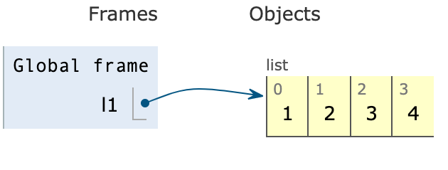
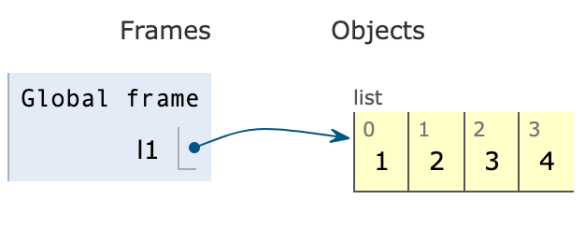
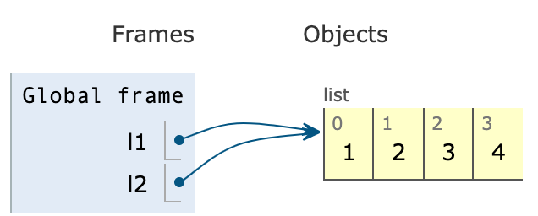
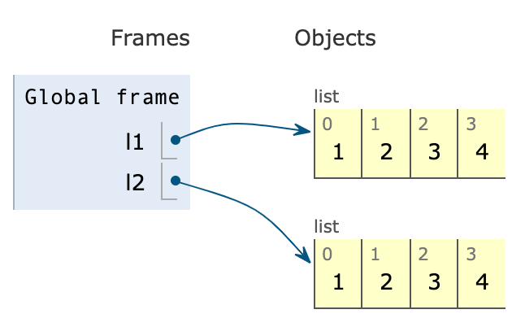
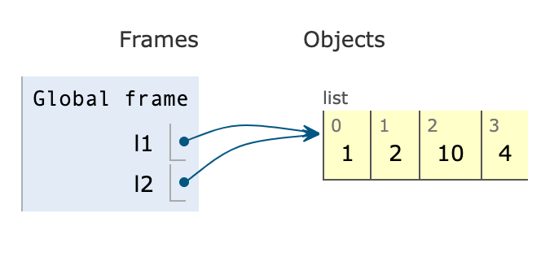
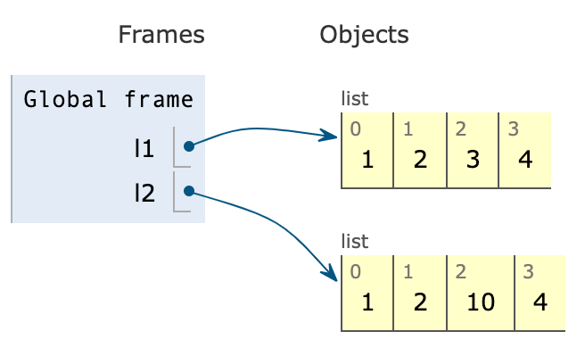
Copying a list - pythontutor.com
l1 = [1,2,3,4]
l2 = l1
l2[2] = 10
print(l1)
print(l2)
l1 = [1,2,3,4]
l2 = l1.copy()
l2[2] = 10
print(l1)
print(l2)

Slide 15
Looping over items in a list
For loop and lists are made for each other - easy to loop
for item in <list>:
Loop_body
====
Looping using index is also easy
N = len(list)
for i in range(N):
use L[i]
Printing items in a list:
for item in list1:
print(item)
====
for i in range(len(list1)):
print(list1[i])

Slide 16
Eg: Sum of squares of items in a list
lst = [1, 3, 2, 5, 9, 4]
total = 0
for item in lst:
total = total + item*item
print(total)
lst = [1, 3, 2, 5, 9, 4]
total = 0
for i in range(len(lst)):
total = total + (lst[i])**2
print(total)

Slide 17
Sorting lists
Lists themselves are any collection of items
Sorting them is a very common need
Python provides a powerful operation, with variations, to sort - treats items as strings and does alphanumeric sorting
lst.sort() # lst changed to have items in ascending order
lst.sort(reverse=True) # lst sorted in descending order
Remember, strings are case sensitive

Slide 18
Special sorting with own key
Can provide own function as "key" for sorting
lst.sort(key=myfn)
Items of list are now arranged based on value of applying myfn on each item
I.e. sorting of items is done as per the value myfn(item) of each item - items do not change
E.g a list of strings
fl = ["orange", "mango", "kiwi", "pineapple", "banana"]
Sorting using fl.sort(key=len) will sort it using the value provided by the len function for each item, i.e. by length
E.g. write a function sq to square the value, use it to sort

Slide 19
Using Lists to Assign Multiple vars
lst = [1,2,3]
How to assign the list elements to variables?
Method 1:
a = lst[0]
b = lst[1]
c = lst[2]
Method 2 (Better way): Sequence unpacking
a,b,c = lst # Now a=1, b=2, c=3
x, y = lst # ValueError: too many values to unpack (expected 2)

Slide 20
Nested Lists
We can have list of lists - creates a 2-D list, like a matrix
l1 = [l11, l12, l13, …] # each of the li is a list of integers
Then li[i] will return a list
To access an item: li[i][j] # jth item in the ith list
This is a matrix
Higher dimensions are also possible - will not discuss them
May work with 2-D lists later

Slide 21
Passing lists to functions
Lists can be passed as arguments to a function
As with any argument - the value of arg is passed to the parm, i.e. the pointer to list object is passed
So, any changes made through the parameter will be reflected back in the list passed as argument
A function can also return a list
def sql (b):
b[0] = 2
b2 = [i*i for i in b]
return b2
a = [1, 3, 5, 7,8]
a2 = sql(a)
print(a)
print(a2)

Slide 22
List Comprehension
In maths you have learned how to construct a set by specifying conditions on the values. E.g.
S = {x: x=n*(n+1) where 0<n<6} # from CBSE book
Ans: S = {2, 6, 12, 20, 30}
Let us form this as a list (can also do set). The statement is:
S = [n*(n+1) for n in range(1,6)]
This is list comprehension: a natural way to form a list; general syntax:
newLst = [ expr(elt) for elt in other_list]
newLst = [ expr(elt) for elt in other_list if condition ]

Slide 23
List Comprehension vs for loop
What list comprehension can do, a for loop can also do, e.g
lst = [n for n in range(10) if n%2==0] # list of even nos
The for loop for this is:
lst = []
for n in range(10):
if n%2 == 0:
lst.append(n)
List comprehension is compact and elegant
It is also computationally more efficient - takes less computer time

Slide 24
List Comprehension Examples
List of even numbers till a number n
even_lst = [i for i in range(n) if i%2 == 0]
List of squares of a list of numbers
lst = [5, 7, 18, …]
sq_lst = [x*x for x in lst]
List of squares of even numbers in a list
squares = [x**2 for x in lst if x%2==0]
List of multiples of items in a list
c = 5
m = [x*c for x in lst]

Slide 25
More List Comprehension Examples
Create a list that contains the elements of the given input list, excluding a given element.
Input: l1 = [2, 3, 3, 5, 7, 3, 4, 3]
Element = 3
Output: res = [2, 5, 7, 4]
l1 = [2, 3, 3, 5, 7, 3, 4, 3]
def remove_all(lst, x):
return [i for i in lst if i != x]
res = remove_all(l1, 3)
print(res)

Slide 26
Quiz : Single Correct
What will be output of the following code :
list1 = [i % 3 for i in range(0, 10, 2) if i % 3 != 0]
print(list1)
[1,2,2]
[1,2,1]
[2,1,2]
[2,2,1]

Slide 27
Quiz : List Comprehension
What will be output of the following code :
list1 = [i % 3 for i in range(0, 10, 2) if i % 3 != 0]
print(list1)
[1,2,2]
[1,2,1]
[2,1,2]
[2,2,1]
Explanation : range(0,10,2) generates values 0,2,4,6,8 ; 2,4 and 8 are not divisible by 3 and leave remainders 2,1 and 2 respectively

Slide 28
Practice For You
Play around with lists on terminal/online
Create lists - try different operations
Write the programs given in the lecture (after closing the slide)
Try creating different types of lists through list comprehensions

Slide 29
Strings

Slide 30
Strings
Strings are within double quotes ("") or single quotes ('')
A sequence of ascii chars - alphabets, numbers, special characters, etc all allowed (except " or ' - as they are delimiters)
New line is a character represented by '\n'
Strings can be assigned to variables, like numbers
s = "Hello, world"
name = "Pankaj Jalote"
Multiple line strings are assigned with three quotes, like
addr = '''IIIT Delhi
Okhla, phase 3'''
In multiline - newline is treated as a character

Slide 31
Strings are compound objects
Strings are a sequence of characters, so can access each char
String also support index and slicing like lists.
In s = "Hello World", s[0] is 'H', s[1] is 'e' ….
Like in list, can loop over a string with characters as items
for c in str:
print(c)
But (unlike list) strings are not changeable (immutable), i.e. cannot change an element, i.e. cannot do:
S[0] = "H" # this is not allowed - give error
While cannot change a string, can create new strings with changes in an existing string through some operations available for it

Slide 32
Slicing Strings
Like lists, can slice strings, E.g.
s = "Hello, World"
s[1:6] # will give 'ello,'
Slicing from start: s[:4] # will be 'Hell'
Slicing till the end: s[6:] # will be ' World'
Negative indexing, i.e. from the end
s [-1] # gives last char, i.e. 'd'
s [-5:] # 'World'; s[-5:-2] # 'Wor'

Slide 33
Operations on Strings
Functions on strings - some similar to list
len(s) # returns the length of string, i.e. the no of characters
str1 = “Hello” # len(str1) returns 5
in: (Membership Testing) Returns true if a character or substring exists in the given string.
"He" in str1 # true
not in: Returns true if a character or substring does not exist in the given string.
“h” in str1 # false

Slide 34
Concatenating / replicating Strings
Joining, i.e. concatenating strings is a common need, + operation, e.g.
first, last = "Pankaj", "Jalote"
name1 = first+last # this will not have a blank between
name2 = first + " " + last # now have a blank
name3 = last + ", " + first # last name first, with comma
* operator for replication
s = "Hello"
res = s*4 # Now res = “HelloHelloHelloHello”

Slide 35
Splitting strings
A string often has sub-strings separated by blank, special char, etc. e.g. a sentence with words
Often you need to get the words in a string
The split() method splits a string and creates a list of substrings. The argument supplied is used as the separator. Splits on whitespaces(spaces,tabs, newline etc..) if no argument is supplied
Example : s = “CSE101, Intro to Programming”
s.split() # separator is any whitespace; returns a list
returns ['CSE101,', 'Intro', 'to', 'Programming']
s.split(‘,’) # splits using “,”;
returns ['CSE101', ' Intro to Programming']

Slide 36
String joining
Often need to join multiple strings (e.g. in a list), with some "separator" between them to form one large string
Items must all be of string type
sep.join(<list of strings>)
",".join(["one", "two"]) will return "one,two"
E.g. Convert a list of integers into a string with blanks in between
l = [23, 34, 45, 56]
ls = [str(i) for i in l]
" ".join(ls)

Slide 37
Modifying Strings
Cannot change a string, but some methods available to create a new string with changes reference to an existing string object, s
s.lower() # gives a str which is s with all lower case
s.upper() # gives a str which is s with all capitals, upper case
s.strip() # str without any blanks at the beginning or end
s.replace("str1", "str2") # string in which str1 in s is changed to str2
Note there is no change of these operations on original string s

Slide 38
Quiz - Alphanumeric
What would be the output of the code given below?
lst = 'Introduction to programming 1 2 3 Hello World'.split()
print(lst[6][-4:-1])

Slide 39
Quiz - Alphanumeric
What would be the output of the code given below?
lst = 'Introduction to programming 1 2 3 Hello World'.split()
print(lst[6][-4:-1])
Output: ell
Explanation: lst[6] refers to the 7th element of lst i.e. ‘Hello’. A slice of this element is printed starting with 4th last character to 2nd last character. (Note that in the slice L[i:j], we go from i upto j-1

Slide 40
Other Methods
Huge number of methods available - all methods return new values - do not change original string
Some we have seen, some others are:
s.count("str") # returns how many times "str" occurs in s
s.find("str") # index from where str is found in s; -1 if not found
s.isalnum() # returns True if all are alpha numeric
s.isdigit() # True if all are digits, else false
s.capitalize() # capitalizes the first char and converts all other characters in the string to lowercase
s.title() # Capitalizes the first letter of every word in the string and converts the rest in lowercase
s.isupper() and s.islower(). # Returns true if s is an uppercase string and lowercase string respectively.
s.startswith(str) and s.endswith(str). # Used for checking suffixes and prefixes

Slide 41
Other Methods
Reverse words in a given string
Recall:
s.reverse() : Reverses the order of items in list
Another way to reverse a list?
Use Slicing
s[::-1]
s = "Introduction to programming"
words = s.split(' ') #creates a list
print(words)
words.reverse()
reverse = ' '.join(words)
print(reverse) # “programming to Introduction”

Slide 42
Escape Characters
To give " or ' in string, use escape char \, i.e. have "Hello \" hi \' xx"
For a newline we have \n
Other escape characters:
\' : single quote
\t : tab
…

Slide 43
String Comparison
Comparison takes place character by character
If corresponding characters at a particular position satisfy the comparison condition, then move to the next position and compare. Otherwise, return False.
Comparisons are case-sensitive
Unicode values of characters are compared. The character with lesser Unicode value is lower.
Let str1 = “Hello”, str2 = “How”, str3 = “hello”, str4 = “Hello”, str5=”Hello World”
print(str1==str3) # False
print(str1==str4) # True
print(str1!=str3) # True
print(str1!=str4) # False
print(str1<str2) # True
print(str1>str2) # False
print(str1<=str3) # True
print(str1>=str3) # False
print(str1<str5) # True
print(str1>str5) # False

Slide 44
Quiz - Alphanumeric
What would be the output of the following code:
str1 = "Introduction"
chunks = str1.split('o') # splits a str using the separator;
for i in chunks:
print(i, end=' ') # with end = ' ', a new line is avoided

Slide 45
Quiz - Alphanumeric
What would be the output of the following code:
str1 = "Introduction"
chunks = str1.split('o')
for i in chunks:
print(i, end=' ')
Output: Intr ducti n
Explanation: The string is split using ‘o’ as the separator and all the chunks obtained after the split and printed with space in between.

Slide 46
Taking Multiple Inputs
In input(), python takes whatever input is given as string
For int, float, bool - we can convert this string, if possible
If the input is not an integer/real number, conversion fails
In input, can give longer text - e.g. a text sentence, many values, .. the entire input is treated as one text string
X = input("Give: ") # input given: 11 22 33 44
print(x) # will give "11 22 33 44"
With string and list operations we can get this as a list of values

Slide 47
Multiple integer (or float) inputs
Suppose you want to give as input values of a, b, c (int) together - How?
Split the input string - this gives you a list of substrings which were separated by "blank" (you can also specify the separator)
X = input("Give: ").split() # input given: 11 22 33
print(x) # will give ["11", "22", "33"]
To get list of integers, list comprehension can be used
int_lst = [int(num) for num in x] # lst is now a list of integers
We can now use this list to get the values of a, b, c
a, b, c = int_lst
Can combine them in one statement:
a, b, c = [int(num) for num in input("Give three numbers:").split()]
# input given WITHOUT commas, must be exactly 3 integers

Slide 48
Quiz : Single Correct
What is the output of the code given?
Error
[1, 2, 3, 4, 5]
[1,2,3,4,5,6,7,8]
[6, 7, 8]
lst = 'Introduction 12345 to 678 programming'
res = [i for i in (int(i) for i in lst if i.isdigit())]
print(res)

Slide 49
Quiz : Single Correct
What is the output of the code given?
Error
[1, 2, 3, 4, 5]
[1, 2, 3, 4, 5, 6, 7, 8]
[6, 7, 8]
Explanation: We first check for digits, finally printing them out as a list.
lst = 'Introduction 12345 to 678 programming'
res = [i for i in (int(i) for i in lst if i.isdigit())]
print(res)

Slide 50
Summary - Lists
Lists are mutable, i.e. they can be changed
Can access a list item, can change the item also
can slice a list to get a sublist - from start or from end of list
Functions with list as parameter: len(), sum()
Operations on lists: in, not in, + , *
Ops on a list: append(), insert(), extend(), remove(), pop(), index(), reverse(), count(), copy(), sort()
Can easily loop over list items - item by item, or using index
Lists can be nested - i.e. list items are themselves lists
List comprehension a compact way to create lists from lists

Slide 51
Summary - Strings
Strings are immutable, i.e. can access a string item, but cannot change the item
Can slice a string to get substrings - from start or end; can loop over string
Functions: len(), in, not in, + , *
Can split strings into a list of items using s.split()
Can join a list of strings to form one using join()
String operations (return a new string): lower(), upper(), replace(), count(), find(), isdigit(), ...
Using string operations and lists and conversion, we can now extract multiple inputs from an input string read by input function

